Slide 1

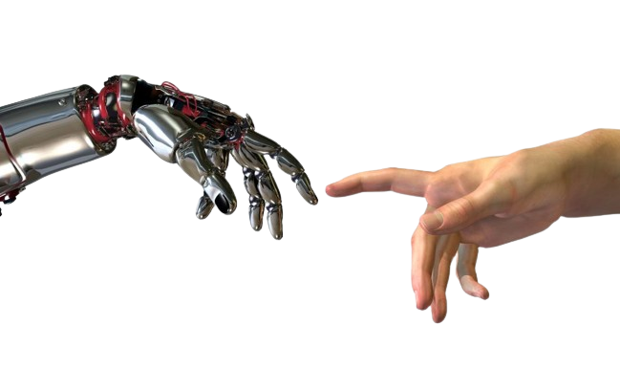
Industrial Internet of Things
INDUSTRIAL INTERNET OF THINGS
Student: Elena-Sabina Onuț
Course: Industrial Informatics

Slide 2


Table of contents
1
Introduction
5
IIoT Protocols
2
IIoT Architecture
6
Implementation
Examples
3
Challenges - Open Issues and Future Directions
7
Bibliography
4
Security

Slide 3


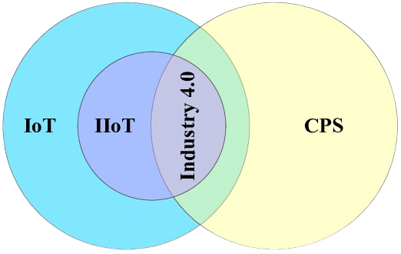


INTRODUCTION
IIoT
The Industrial Internet of Things (IIoT), also known as Industry 4.0, is an emerging technology that can revolutionize manufacturing and production by using a significant number of networked embedded sensing devices and integrating cutting-edge computing technologies [6].
CPS (Cyber Physical Systems) - symbiosis between certain industrial equipment and an IT infrastructure plus a production one.
Key components and concepts: sensors, actuators, connectivity protocols, edge computing, cloud computing, distributed systems, big data, AI, and digital twin. These components work together to enable real-time data collection, analysis, and decision-making, empowering industries to optimize processes, predict maintenance needs, and enhance overall efficiency.

Slide 4
OBJECTIVES OF IIOT
1
2
3
4
5
Collection of data
Real-time management
Optimizing manufacturing processes
Maintenance,
Sustainability and Circular Economy
Support for: smart cities, smart transportation

Slide 5
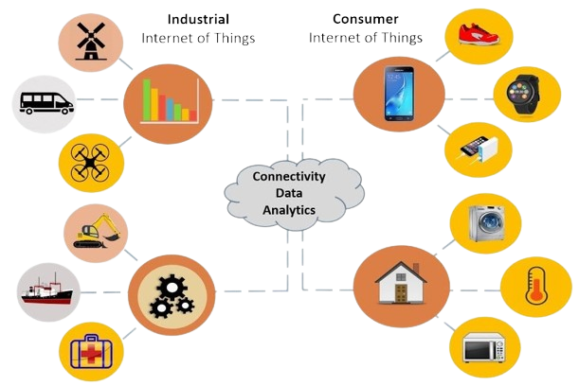
IOT VS IIOT
IoT and IIoT are both technologies that involve the interconnectivity of devices, but they have distinct applications and focuses.
While IoT targets consumer applications, IIoT is tailored specifically for industrial environments, driving advancements in manufacturing, logistics, energy, and other industrial sectors through the integration of IoT technologies.

Slide 6
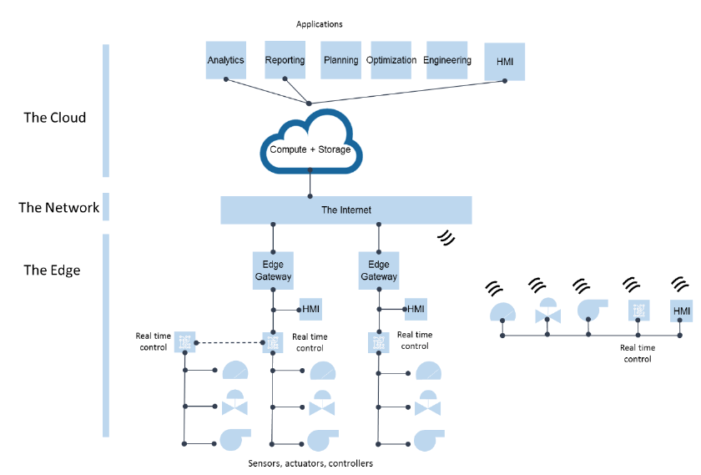
IIOT ARCHITECTURE
The architecture of IIoT consists of the following key layers:
Edge Layer: consist of physical components.
Network Layer: includes IoT gateways, edge routers, or IIoT PLCs.
Cloud Layer: the core of the IIoT systems.
Stores processed data for future analysis and decision-making, it includes protocols and technologies that enable seamless connectivity and data exchange between devices and systems.
Application Layer: Provides user interfaces for monitoring and control.
Security: Implements measures to protect data and systems from cyber threats - encryption, authentication, access control, and others.
There are several architecture models for IIoT systems, no general one is selected.

Slide 7
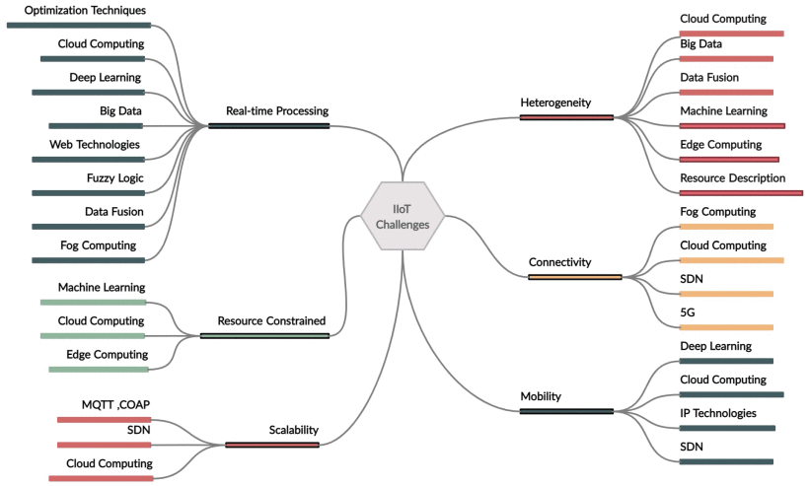
IIOT CHALLENGES
INDUSTRIAL INTERNET OF THINGS

Slide 8

IIOT CHALLENGES
CONNECTIVITY
REAL-TIME PROCESSING
Ensuring communication between various elementary devices and the Internet to which they connect.
Performance Expectations
Industrial networks (e.g. CAN, Profibus, FieldBusFoundation) are difficult to integrate into current WAN networks (e.g. Internet)
A large number of devices - limited connectivity
General reference model
Efficient real-time processing stands as a critical imperative given the substantial volume and complexity of generated data.
Essential for facilitating timely decision-making and feedback mechanisms within IIoT ecosystems.
Lack of real-time communication protocols (to respect time constraints)
BIG DATA PROCESSING AND ANALYTICS
SECURITY
Insufficient address space for volume of pluggable devices (tens of billions).
Bandwidth and storage limitations
Power consumption
Processing limitations
Leveraging technologies like Hadoop and Apache Spark, these architectures enable parallel processing and real-time analytics.
Common security threats faced by industries implementing IIoT:
Denial of Service (DoS) Attacks
Side Channel Attacks
Cloud Malware Injection
Authentication Attacks
Malware Attacks
Data Manipulation

Slide 9
OPEN ISSUES AND FUTURE DIRECTIONS
CONNECTIVITY
REAL-TIME PROCESSING
Edge Computing: Processing data closer to its source.
reduce bandwidth constraints
reduce latency by processing data locally
Mesh Networks: Self-healing networks for better connectivity.
devices can communicate to each other directly
Advanced Wireless: 5G and beyond for higher bandwidth, lower latency, and increased reliability.
Stream Processing: Immediate analysis of data streams.
Apache Kafka, Apache Flink framewroks => real time analysis of data streams
Edge Analytics: Quick response by processing data locally.
processing data before transmitting to the cloud => reduce latency
Complex Event Processing (CEP): Real-time pattern detection.
BIG DATA PROCESSING AND ANALYTICS
SECURITY
Distributed Computing: Scalable processing across multiple nodes.
Apache Hadoop, Apache Spark frameworks enables scalable processing of high volumes of data.
Data Lake Architectures: Centralized storage of structured and unstructured data, for analysis.
Machine Learning and AI: Automated analysis and predictions.
Blockchain Technology: Relies heavily on security – tamper-proof ledger = once a transaction is confirmed and entered on the ledger, the entry cannot be modified without detection.
Zero Trust Architecture: Every device and user is verified and authenticated before accessing IIoT systems or data.
Secure Hardware: Hardware-based root of trust. Examples: Trusted Platform Modules (TPM) or Hardware Security Modules (HSM).

Slide 10
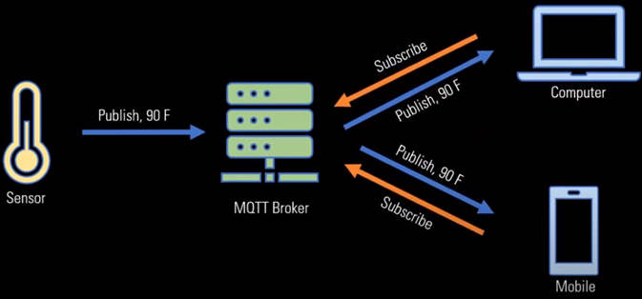
IIOT PROTOCOLS
1. MQTT – MESSAGE QUEUING TELEMETRY TRANSPORT
MQTT primarily operates at the Application Layer
Is a lightweight published subscribed messaging protocol, design for remote monitoring and low bandwidth, high latency networks.
Ideal for scenarios where reliable communication and efficient data transmission are crucial.
It is suited for applications like smart agriculture, logistics, and remote asset management.

Slide 11
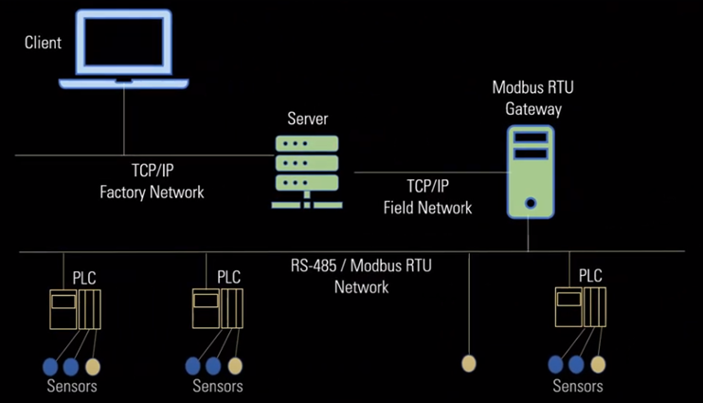
IIOT PROTOCOLS
2. MODBUS
Is a simple and widely adopted protocol for communication between electronic devices
It is widely used in SCADA systems process automation and industrial control applications
It comes at different variants including Modbus RTO, serial, and Modbus TCP ethernet
It facilitates communication between programmable logic controllers, PLCS, and other devices

Slide 12
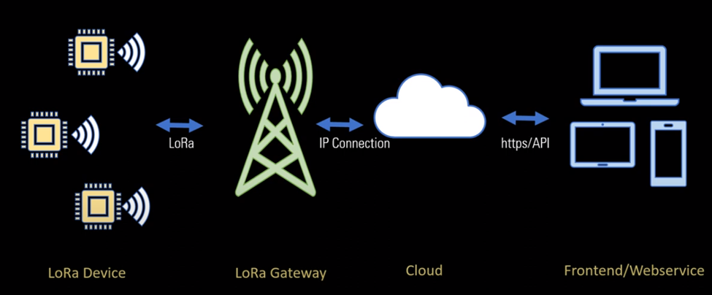
IIOT PROTOCOLS
3. LORA – LONG RANGE
Is a wireless communication technology designed for long range low power applications
It is suitable for remote sensing monitoring and control in industrial environments
It enables long range communications while conserving battery life

Slide 13
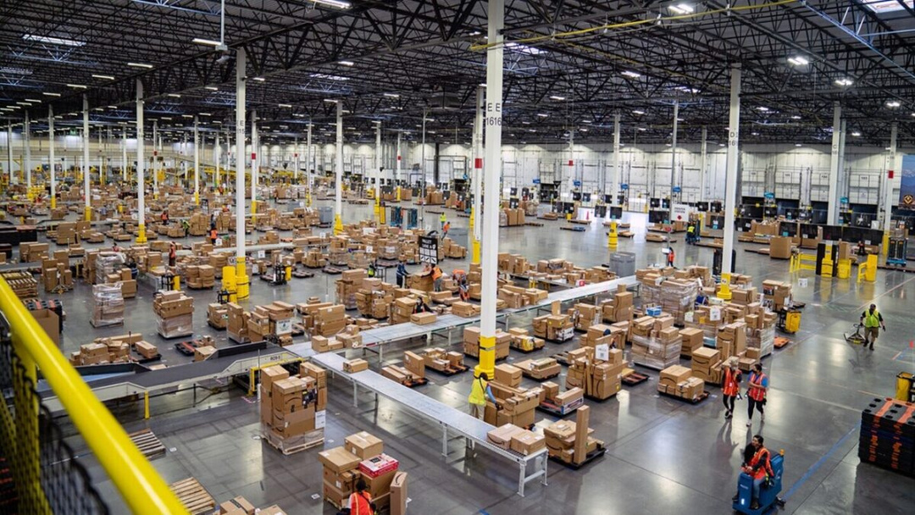
AMAZON: Reinventing Warehousing
Amazon is the world’s biggest retailer.
Symphony of humans and machines working together.
Uses deep learning AI from 2015.
KIVA robots - to streamline operations - from 2012.
PEGASUS robots - new iteration of KIVA - 2018.
XANTHUS robots - 2020.
ROBO-STOW - robotic arm.
SLAM machines - labeling robots.
CANVAS technology - autonomous robotic carts .

Slide 14
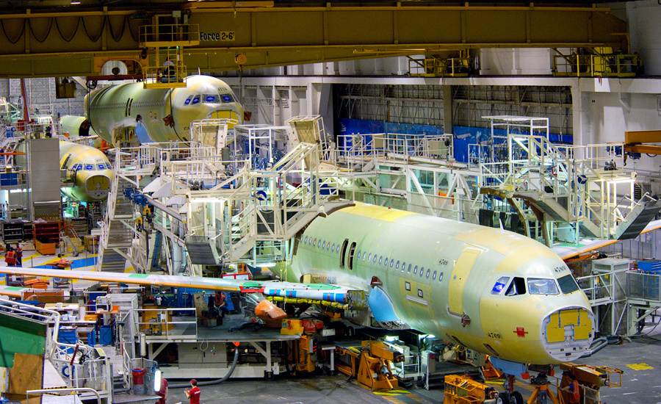
AIRBUS: Smart Factory
Leading manufacturer of aircraft and a pioneer of innovation.
Millions of components.
Factory of the Future.
Incorporates various IoT technologies throughout its production processes:
Sensors in the machines and workers’ uniforms -> to increase safety and reduce errors.
Ex: smart glasses that allow employees to decipher complex blueprints and convert measurements from imperial into metric.
These advancements have been deployed in the assembly lines of A330 and A350 models at the Toulouse manufacturing plant, as well as in the assembly operations for the A400M model in the UK.

Slide 15
AIRBUS: Smart Factory
State-of-the-art-production lines
Innovative handling systems & exoskeleton
Immediate safety alert with mobile device
Live remote project collaboration
Connected factory
Integrated digital design
Interactive work instructions
Intensive use of mixed reality
Online quality check for connections improvement
Manufacturing robots for efficient assembly
Using big data and AI
interconnection supplier’s and Airbus Atlantic’s ERP systems;
up to 6 billion data processed each week per supplier, using AI;
early detection of potential missing parts, even before production launch.
Real-time machine performance monitoring (a single wireless device suitable to all machines)
Collaborative robotics for logistics
Automated quality check

Slide 16
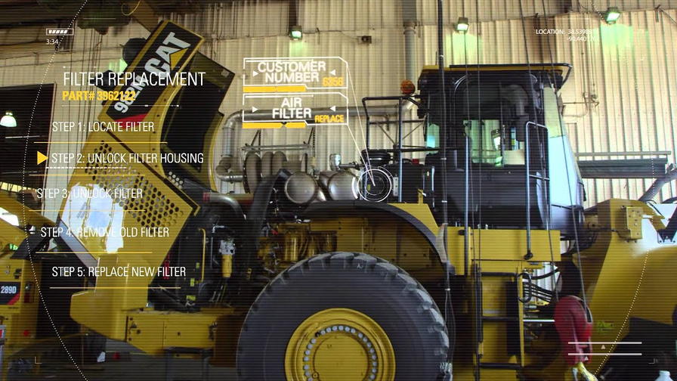
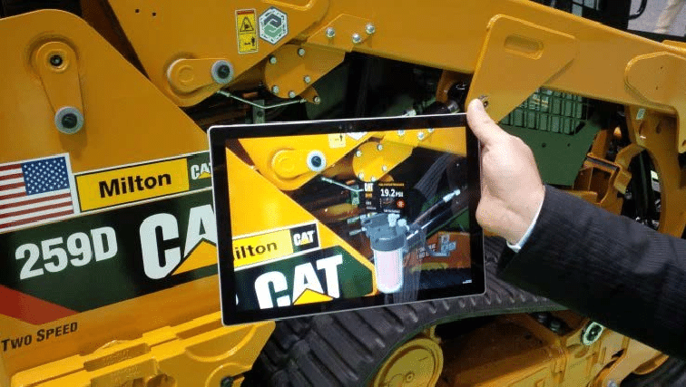
CATERPILLAR - Augmented Reality App
Caterpillar is a heavy equipment maker.
Augmented reality (AR) app which is integrated with IoT.
used for repair work
generates end-to-end view of the factory floor.
the machine operators can detect the need for tool replacement, air filter change, fuel monitoring, etc.
The process has the following steps:
the employee responsible for the repair or maintenance of the forklift truck uses a special tablet to read the data from the unique label for each object, which allows to identify the equipment. After that, by focusing the tablet on the machine parts, the engineer can see how and in what sequence it is necessary to operate to replace the detail or change the oil.

Slide 17
BIBLIOGRAPHY
Boyes, Hugh; Hallaq, Bil; Cunningham, Joe; Watson, Tim (October 2018). "The industrial internet of things (IIoT): An analysis framework". Computers in Industry. 101: 1–12.
Sari, A., Lekidis, A., Butun, I. (2020). Industrial Networks and IIoT: Now and Future Trends. In: Butun, I. (eds) Industrial IoT . Springer, Cham. https://doi.org/10.1007/978-3-030-42500-5_1.
Lee, C. & Huo, Yunzhang & Zhang, Shuzhu & Ng, Kam K.H.. (2020). Design of a Smart Manufacturing System With the Application of Multi-Access Edge Computing and Blockchain Technology. IEEE Access. PP. 1-1.
Peter, Onu, Anup Pradhan, and Charles Mbohwa. "Industrial internet of things (IIoT): opportunities, challenges, and requirements in manufacturing businesses in emerging economies." Procedia Computer Science 217 (2023): 856-865.
Grover, Jyotsana. "Industrial IoT and Its Applications." IoT for Sustainable Smart Cities and Society. Cham: Springer International Publishing, 2022. 107-124.
Jaloudi, Samer. "Communication protocols of an industrial internet of things environment: A comparative study." Future Internet 11.3 (2019): 66.

